Slide 1
Urban Expansion and Land Use Monitoring Using Custom Machine Learning Models
Group 17
ENGG 680 - Introduction to Digital Engineering
Tirth, Panchal 30240101 tirth.panchal@ucalgary.ca
Kandarp, Rathod 30267885 kandarppankajbhai.ra@ucalgary.ca
Parth, Bhamani 30146903 parthrajeshbhai.bham@ucalgary.ca
Obehi, Edeoghon 30240132 obehi.edeoghon@ucalgary.ca
Chan Nyein, Aung 30217709 channyein.aung@ucalgary.ca
Soheil, Seifi 30229496 soheil.seifi@ucalgary.ca
Seyedehshima, Moradi 30203561 Seyedehshima.moradim@ucalgary.ca
Zohreh, Mejrisazantoosi 30232335 zohreh.mejrisazantoo@ucalgary.ca

Slide 2
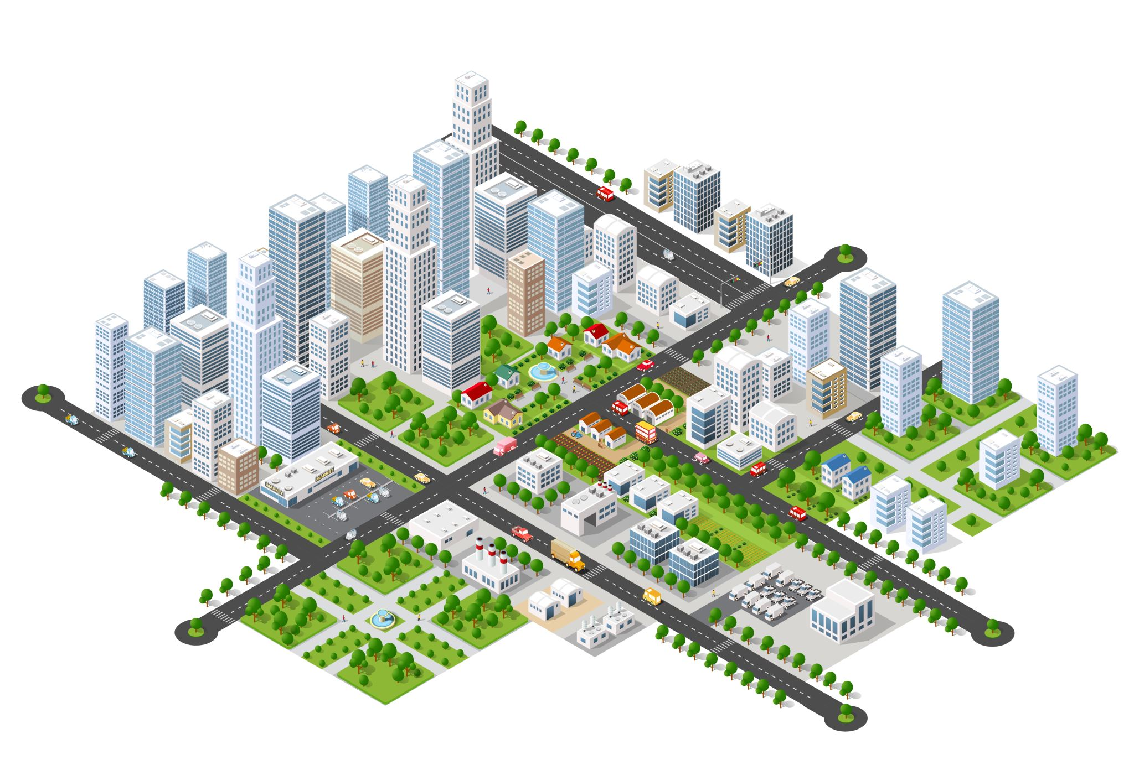
Introduction
Problem Statement:
Increasing car accidents in urban areas.
Impacts of urban expansion and climate change.
Objective:
Develop a machine learning model to predict traffic accident hotspots using historical accident data, weather, and urban growth factors.
Significance:
Provides actionable insights for city planners and engineers to enhance road safety and infrastructure.

Slide 3
Existing Solutions and Gaps
Current Approaches:
Traditional statistical models (linear regression, logistic regression).
Advanced ML models (neural networks, SVMs).
Gaps Identified:
Lack of urban growth integration.
Limited predictive accuracy in dynamic conditions.
Geographic localization of existing solutions.

Slide 4

Methodology Overview
Steps:
Data Collection and Cleaning.
Machine Learning Model Development.
Model Validation and Tuning.
Results Analysis and Insights.
Data Sources:
Traffic Incidents (City of Calgary).
Historical Weather Data (Government of Canada).

Slide 5
Data Preparation
Accident Data:
Cleaned and analyzed historical traffic data (2017–2024).
Extracted features: Date, Time Period, Clusters, Incident Types.
Weather Data:
Preprocessed variables: Temperature, Humidity, Wind Speed, Visibility.
Integrated weather data with accident records by date and time.

Slide 6
Model Development
Models Used:
Support Vector Machine (SVM).
Random Forest Classifier.
Features:
Combined traffic and weather data.
Targets:
Multi-label prediction for clusters (Cluster0–Cluster5).
Time-lagged features for clustering (e.g., C0D-1HA, C1D-2HA).

Slide 7
Hyperparameter Tuning
Grid Search:
Used 5-fold cross-validation.
Best Parameters:
Random Forest: n_estimators=100, max_depth=10.
Explored parameters for SVM (C, gamma) and Random Forest (n_estimators, max_depth).
SVM: C=1, gamma=0.1.

Slide 8
Results
Performance Metrics:
Accuracy, Precision, Recall, F1-Score.
Visualizations:
Confusion Matrices and Classification Reports.
Comparative performance of SVM and Random Forest.
Key Findings:
High prediction accuracy for clusters with substantial data.
Weather conditions significantly affect accident predictions.

Slide 9
Insights and Applications
Insights:
Accident hotspots identified in specific clusters.
Weather significantly impacts traffic incidents.
Applications:
Enhancing traffic management systems.
Informing urban planning and road improvements.
Designing smarter vehicles with accident-prevention features.

Slide 10
Limitations and Future Work
Limitations:
Limited real-time data integration.
Geographic scope confined to Calgary.
Incorporate real-time IoT data.
Extend the model to other urban areas.
Explore advanced deep learning techniques
Future Directions:

Slide 11
Conclusion
Summary:
Successfully developed a predictive model for urban traffic accidents.
Integrated traffic and weather data for enhanced accuracy.
Impact:
Provides a scalable framework for improving urban safety and infrastructure planning.

Slide 12

References

Slide 13

Questions

